Slide 1
Introduction to Data Preprocessing

Slide 2
Agenda
Data Preprocessing Overview
Dealing with Duplicates
Dealing with Missing Values
Dealing with Outliers
Dealing with Categorical Data
Data Normalization and Scaling
Data Transformation
Feature Engineering
Summary
Hands on

Slide 3
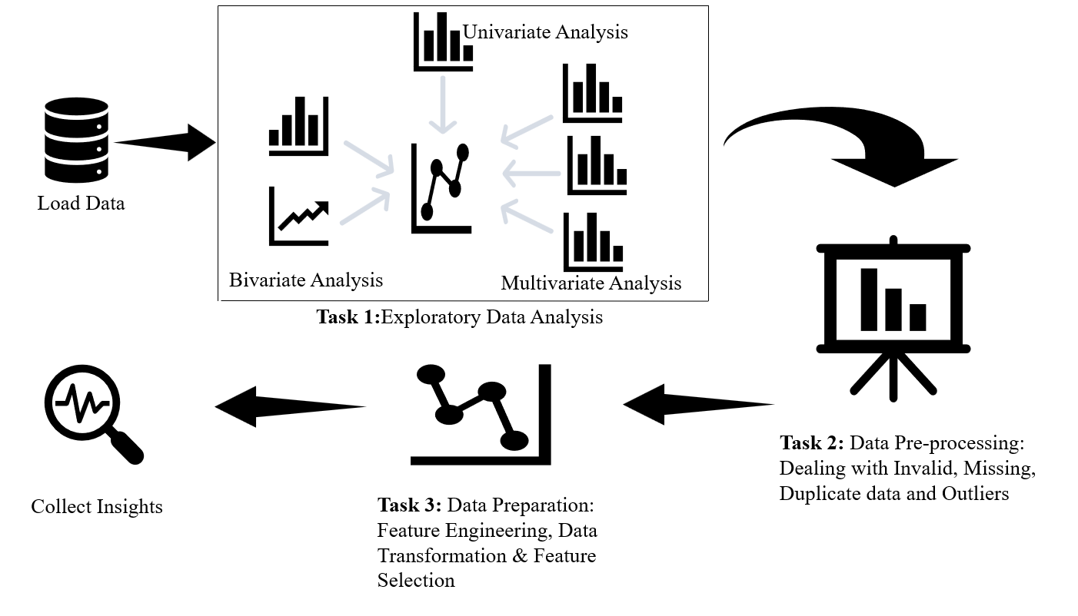
Data Preprocessing Overview

Slide 4
Data Preprocessing
Includes major preprocessing steps that help in cleaning and generating suitable features from the raw data
These features can be used to build the machine learning model
A few specific steps depend on the data at hand
Domain expertise is highly appreciated
Statistical knowledge is required to select suitable features
Dealing with duplicates
Dealing with categorical data
Data Preprocessing
Dealing with missing values
Dealing with outliers

Slide 5
Dealing with Duplicates
There could be some duplicate records in the data and it could lead to poor analysis
We can remove the duplicate records
Pandas provides df.duplicated() function to check whether a duplicate entry exists in a DataFrame or not.
It returns a boolean series which identifies whether a row is duplicate or unique.
We can remove the duplicates by using pandas df.drop_duplicates() function.

Slide 6
Dealing with Missing Values
For various reasons data might contain missing values
Structurally missing:
When data is missing because it is not supposed to be there.
Missing At Random (MAR):
When we assume that the missing data can be predicted from other attribute values. It mean that it is not actually missing.
Missing Not At Random (MNR):
Data is missing due to some reason we don’t know what it is. This can happen in repeat research such as in customer behavior tracking.

Slide 7
Ways to deal with Missing Data
We can follow the below best practices to impute missing data. There is not any fixed rule for it, however we can have a generalized thumb rule.
Condition
Method
Very high number of missing values (>60%)
Percentage of missing data is negligible (0.05)
Missing data in a continuous feature
Missing data in a categorical feature
Collect more data or drop the feature
Drop the rows having missing data
Mean/median
Mode

Slide 8
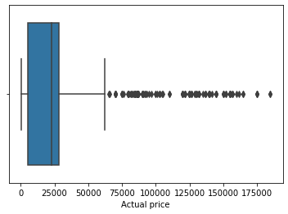
Dealing with Outliers
Outliers are extreme data points
They deviates so much from other observations as to arouse suspicion that it was generated by a different mechanism
They appear to be inconsistent with the remainder of that set of data.
Can be identified through: Box plot, z-score, Interquartile range (IQR)
Notes:
Graph taken from hands-on

Slide 9
Functions for Data Cleaning
Common methods and functions for data cleaning:
Function
Definition
df.str.replace():
df.set_index():
df.str.split():
It works similar to Python replace() method. It can be used to treating the invalid values in a variable.
It is used to set existing column of a dataframe as dataframe index.
It can be used to separate a string of a column into two different columns.

Slide 10
Data Normalization and Scaling
Used to transforms the different scaled data into a common scale.
Many machine learning algorithms are distance based and scale of the data can influence the outcome. Hence, scaling is an important step.
Min max scaling:
fixed range 0 to 1
Max absolute scaling:
ranges between -1 to 1
Standard scaling also called z– score:
(ranges from -3 to 3)

Slide 11

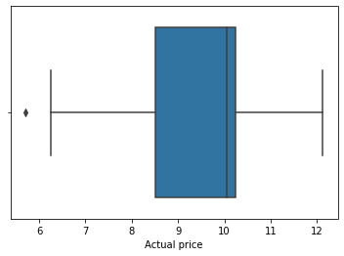
Data Transformation
Data Transformation: Converting raw data into a particular format that suits best for the model
Log Transformation is used when dataset follows power law distribution
Clipping is used to handle outliers in the dataset
Data scaling is used to transform the data into the same scale

Slide 12
Feature Engineering
Feature engineering is the process of transforming features from the state they are in to a state where they are likely to contribute to the model accuracy.
Feature engineering includes:
Removing redundant features. Example: dropping IDs
Transformations: transforms features from one representation to another. Ex. log transformation
Feature Extraction: extracting features from dataset to identify useful insights about the data. Ex: binning a categorical feature by reducing number of categories.
Generating new features from existing ones. For example creating age from the date of birth.

Slide 13
Hands on
Case Study: Data Preprocessing on Amazon Smartphones & Accessories dataset
Objective:
To explore the Amazon dataset by performing data analysis using python libraries. And to perform data pre-processing steps to process, manipulate and clean the raw data.
We will implement different preprocessing steps such Data cleaning, Normalization and Scaling, Feature Engineering and so on.
Dataset Description:
Amazon Top Rated Smartphones & Accessories 2021 Dataset was scraped from amazon.in website of the e-commerce amazon India.
The dataset contains smartphones title with its specification according to its rating and number of review count in the dataset column.
There is a piece of additional information about the smartphone. that is its offer price and actual price with its discount percentage and delivery options

Slide 14
Hands on
Note that in the dataset, datatype of all the features is in object type and has some unwanted characters like comma's and '₹' sign. We will Try to remove unwanted characters in the data and convert the data types to their suitable data types.
We will Write a function to create a new column as 'Rating_category'. If the rating is greater than 3.5 group those records as high and rest as low.
Most of the machine learning algorithms cannot handle the categorical data. Hence we need to encode the categorical columns in order to feed the data for model building. We will encode the categorical columns using appropriate technique and prepare the data for model building.

Slide 15
Summary
In this module we discussed:
Data Pre-processing
Dealing with duplicates, outliers, missing values and categorical data
Cleaning of data, and data transformation
Feature Engineering
Normalization and Scaling the data
Notes:
Diagram created Internally

Slide 16
Module Summary
In week 3 (Working with Python libraries):
We discussed different libraries like numpy and pandas that are used to deal with data efficiently.
We understood data structures like arrays, series, and dataframes and explored their various features.
We performed basic operations on the iris dataset using Numpy.
We also explored the customer churn dataset and performed data analysis using pandas library.
We saw how to load a data, explore the data, and get basic insights from it.
Notes:
Diagram created Internally

Slide 17
Module Summary
In week 4 (Visualization):
Here, we understood the importance of visualization and different plots and charts supported by Python libraries like matplotlib and seaborn.
We analyzed the titanic data using different plots supported by matplotlib and seaborn and derived some meaningful insights.
We saw various charts, their characteristics, and applications.
Notes:
Diagram created Internally

Slide 18
Module Summary
In week 5 (EDA):
We understood the important role of exploratory data analysis.
We learned about the different types of variables, measures of central tendency, dispersion, and shape of distributions, correlation and covariance.
We analyzed the cars dataset to summarize their main characteristics using pandas, statistical graphs, and other data visualization methods.
We tried to answer certain questions and verified assumptions about various features and derived insights from it by performing exploratory data analysis.
Notes:
Diagram created Internally

Slide 19
Module Summary
In week 6 (Data Preprocessing):
We learnt and implemented different preprocessing steps such as dropping duplicates, dealing with missing values, outliers, and categorical data.
We understood the importance of normalization and scaling the data, and also performed data transformation, and created some new features using feature engineering approach.
We explored the Amazon dataset by performing data analysis using python libraries. And we performed data pre-processing steps to process, manipulate and clean the raw data.
Notes:
Diagram created Internally

Slide 20
Thank you Happy learning ☺

